Slide 1
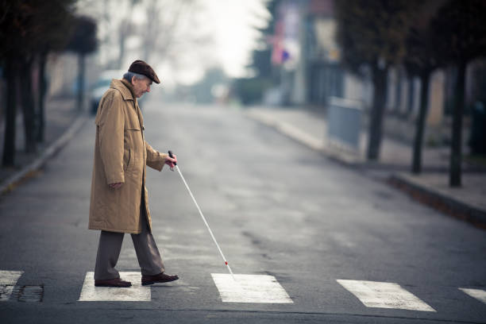



Slide 2

NEED of this Project:-
Globally, 2.2 billion people live with some form of vision impairment (World Health Organization).
India alone has 4.95 million blind individuals and 70 million with vision impairments, including 0.24 million blind children (National Institutes of Health).
In low-income countries, nearly 90% of people with disabilities lack access to necessary assistive technology (World Health Organization).
The lack of affordable solutions limits the independence and quality of life for individuals with visual impairments.

Slide 3
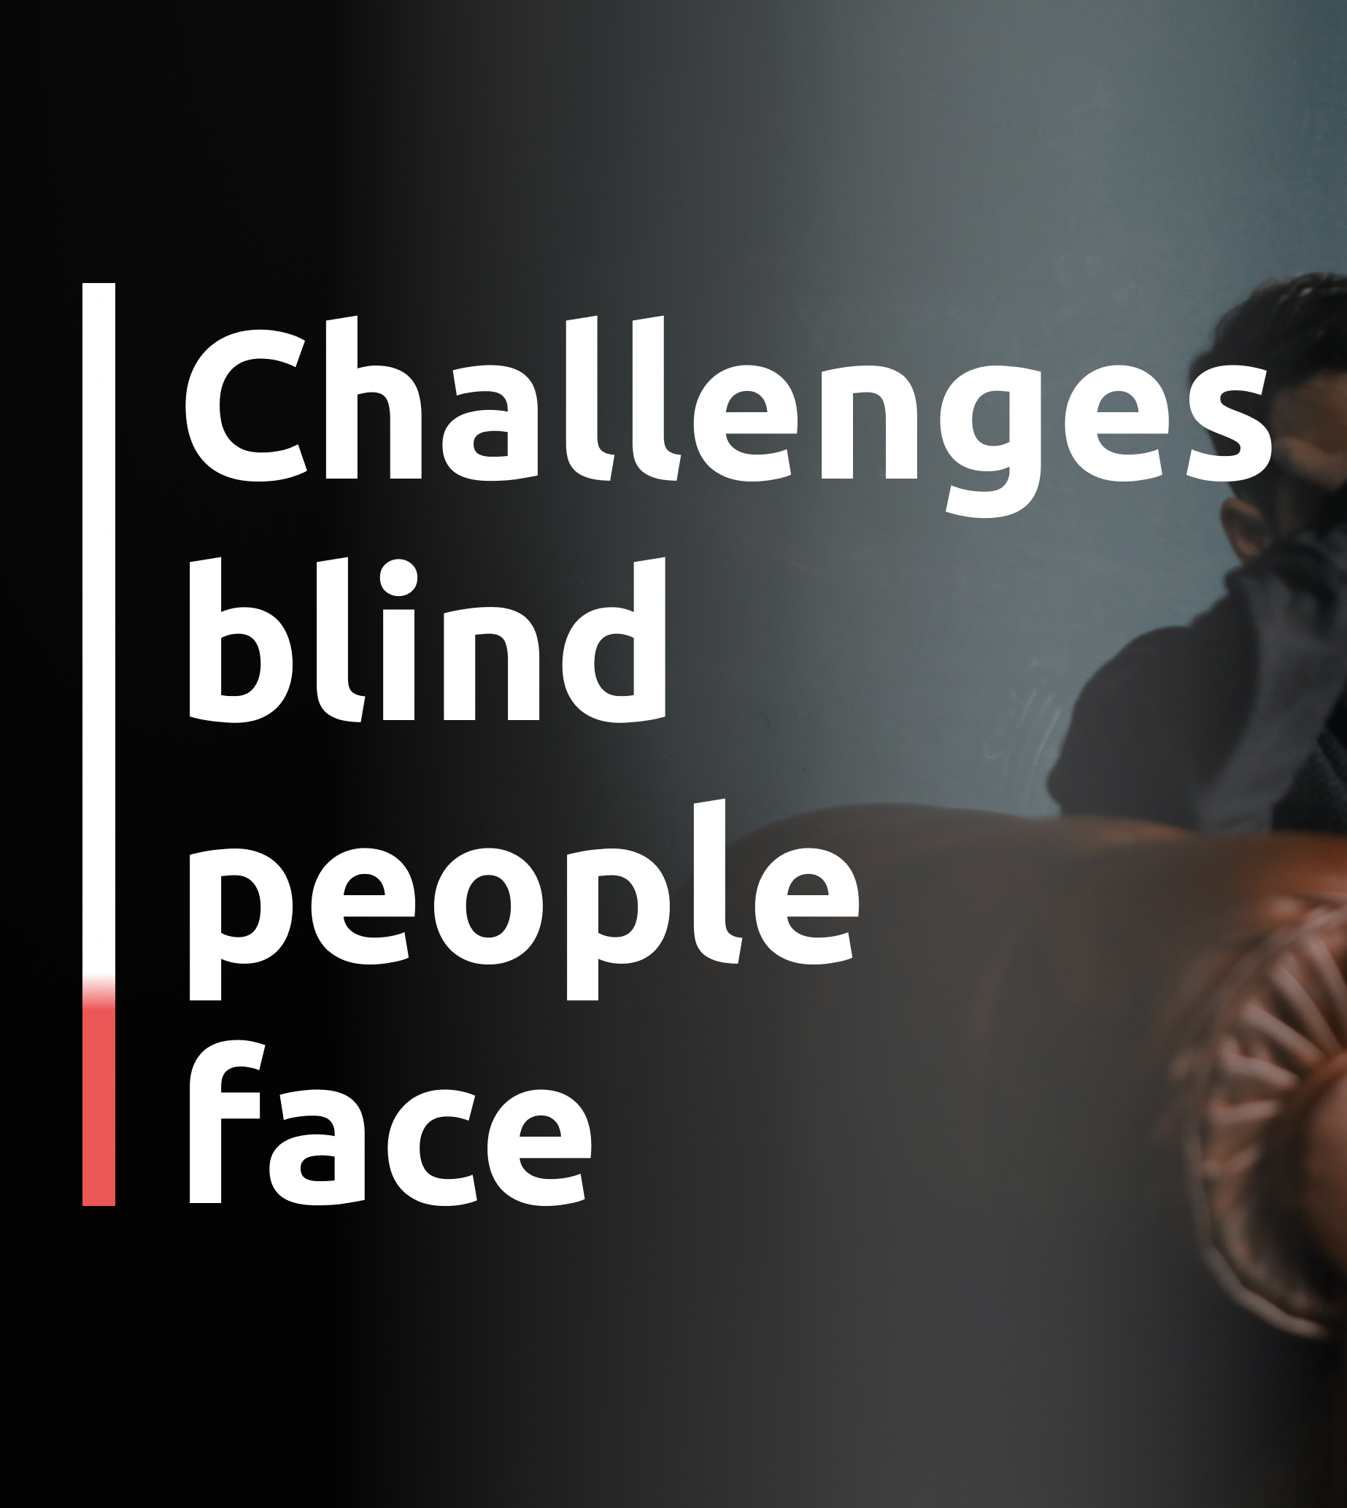
Limited Independence
Safety Concerns
Information Accessibility
Financial Constraints
Technology Barriers

Slide 4

Objectives:-
Enhance Independence
Improve Safety
Affordability
Facilitate Access to Information
Leverage Advanced Technology

Slide 5

Key Features:-

Slide 6


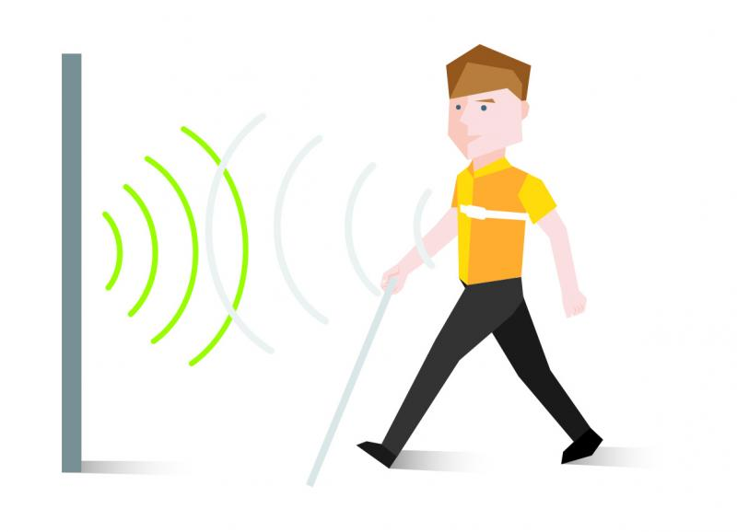
Sensor Data Acquisition

Slide 7
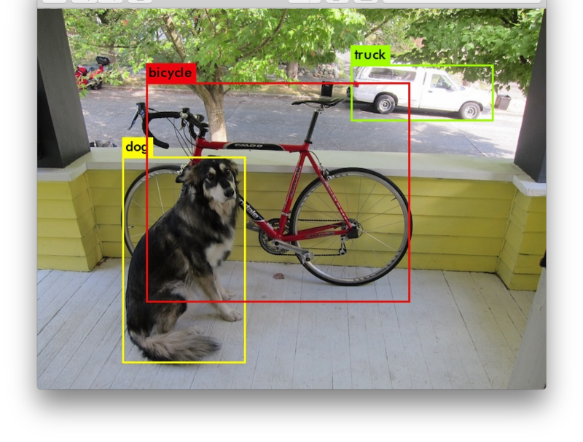
Object Detection

Slide 8

Text and Signboard Detection

Slide 9
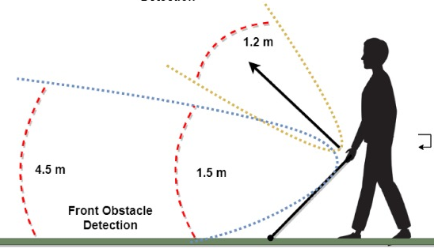
Distance Measurement

Slide 10
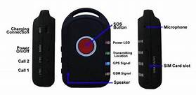
GPS Navigation
And
SOS Functionality

Slide 11
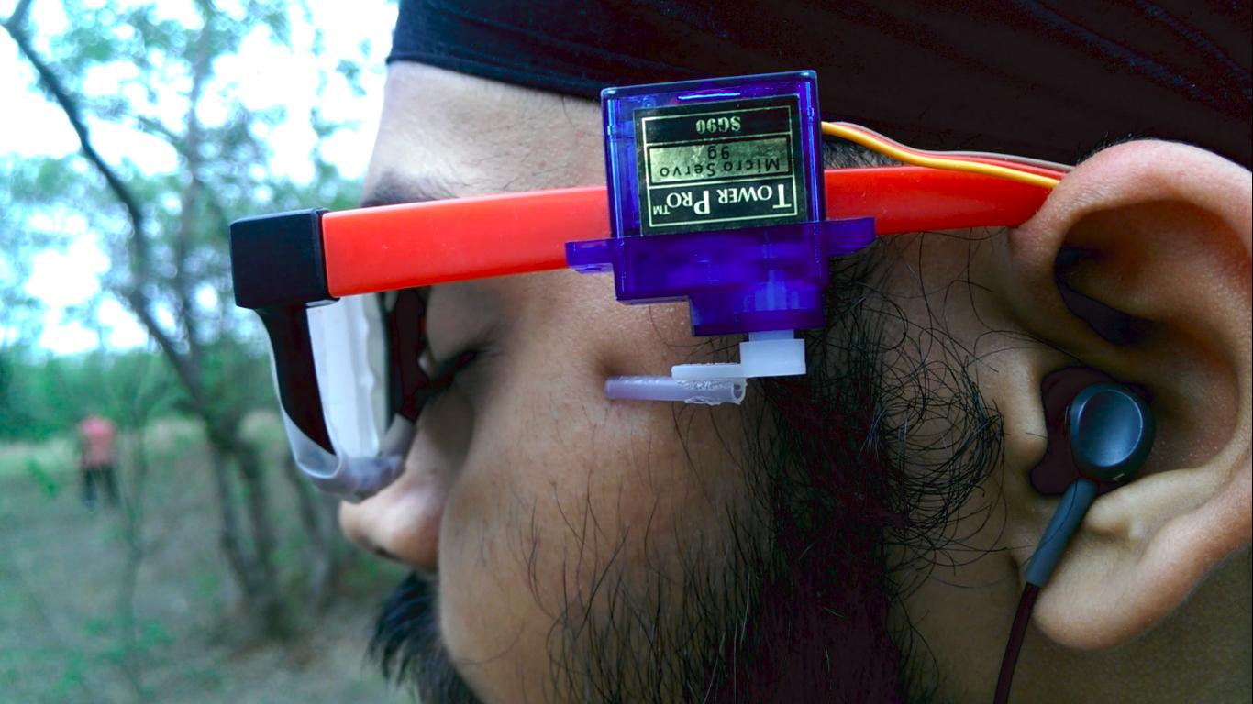
Audio Output

Slide 12

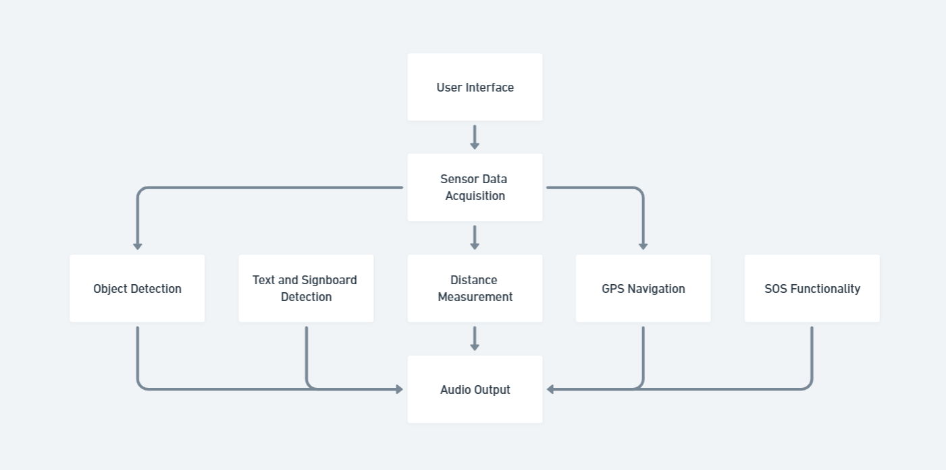
WorkFlow Diagram

Slide 13



Team members:-
Vibhore Jain
Tanmay Arora
Swapnil Bhatnagar
Neeraj Gandhi

Slide 14

Thank you

